Slide 1

Enhancing Medical Education through Immersive Virtual Reality
MetaMed:
Group Members
Dawood Sarfraz (20P-0153)
Waleed Akram (20P-0640)
Shoaib Akhtar (20P-0147) Project Supervisor
Dr. Muhammad Amin

Slide 2
Table Of Content
Introduction
Problem Statement
Objective
Diagrams
Tools Used
App Highlights
Gantt Chart
Demo

Slide 3
1. Introduction

Slide 4
Introduction
A VR-based medical training platform
Develop VR medical simulations with haptic feedback, enabling realistic training for medical students
Reduce costs and ethical concerns associated with traditional surgical training methods

Slide 5
Problem Statement
Safety Risks
High Cost
Limited Access
Lack of Repetitive Practice
Poor Collaboration

Slide 6
Objective
VR Medical Simulations
Guided Procedures
Multi-User Capability
Mobile Accessibility
Collaboration

Slide 7
2. UML Diagrams

Slide 8
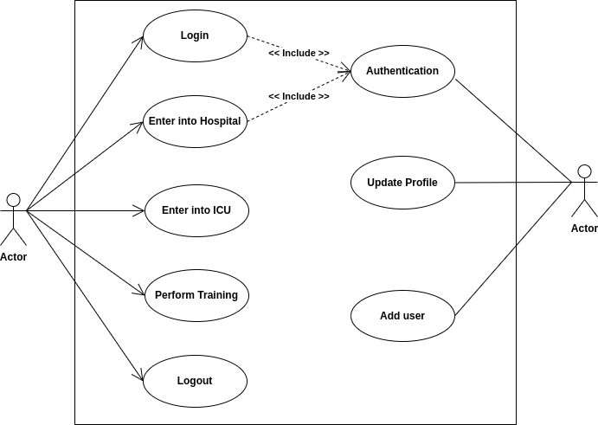
Use case Diagram
Fig.1 Use Case Diagram

Slide 9
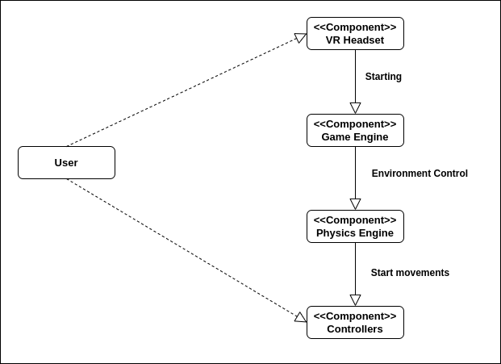
Component Diagram
Fir. 2 Component Diagram

Slide 10
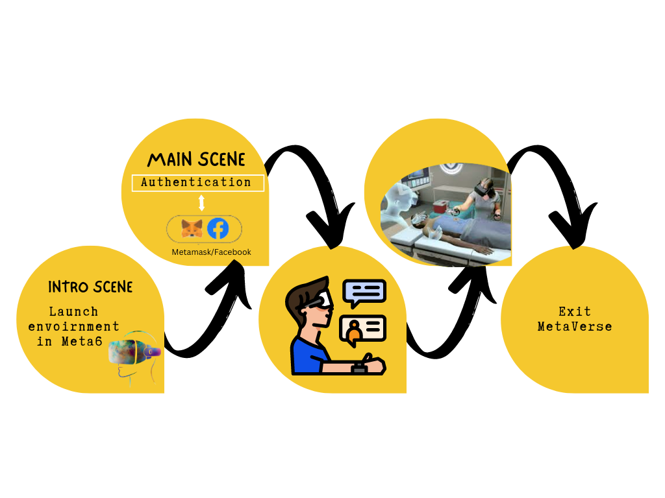
Workflow Diagram
Fig. 3 Workflow Diagram

Slide 11
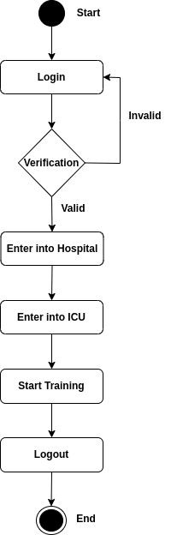
Activity Diagram
Fig.4 Activity Diagram

Slide 12
Tools Used
Blender
Unity 3D
VR Headset
Microsoft Visual Studio
C#
Photon (For Server for Multi user)

Slide 13
3. App Highlights

Slide 14
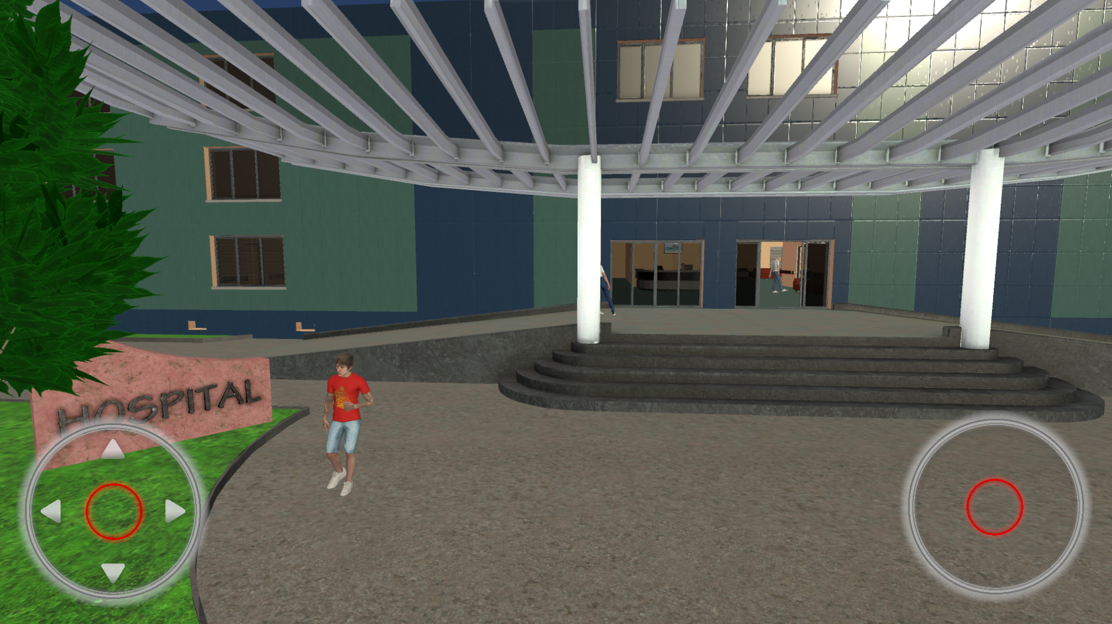
Main Entrance
Fig.3 Hospital Main Entrance

Slide 15
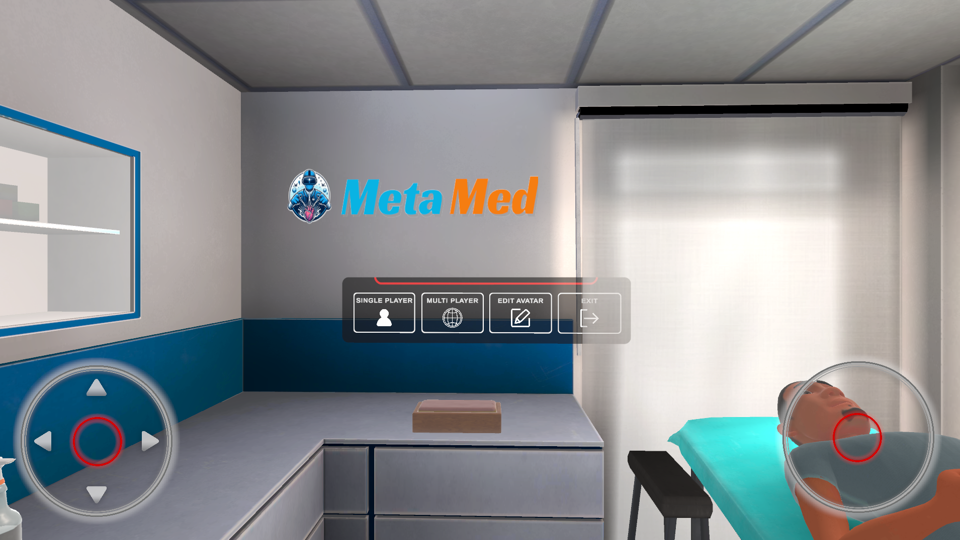
User Manual
Fig.4 User Manual

Slide 16
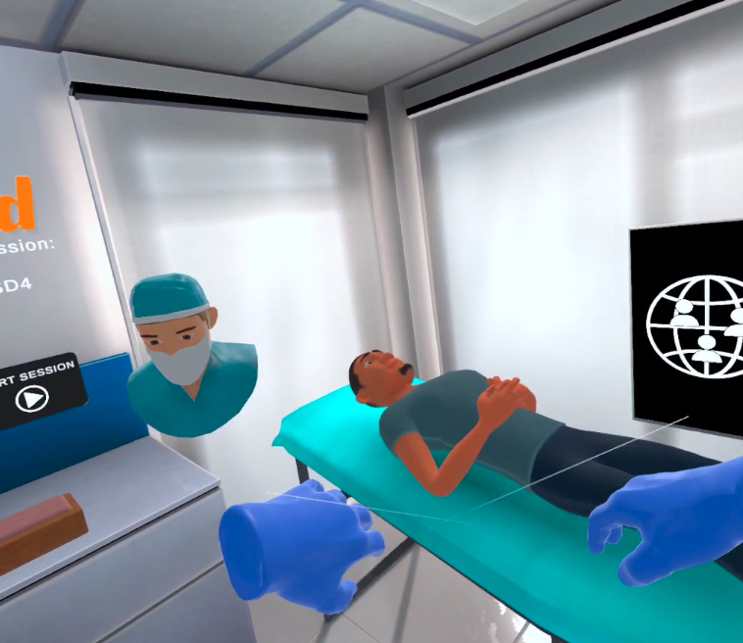
Multi User
Fir.5 Multi user

Slide 17
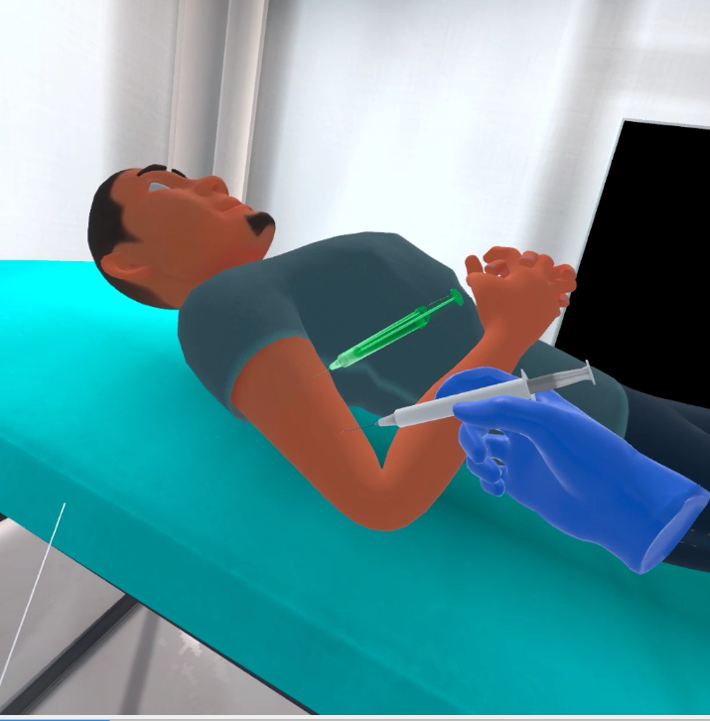
Performing Tasks
Fig. 6 Injection

Slide 18
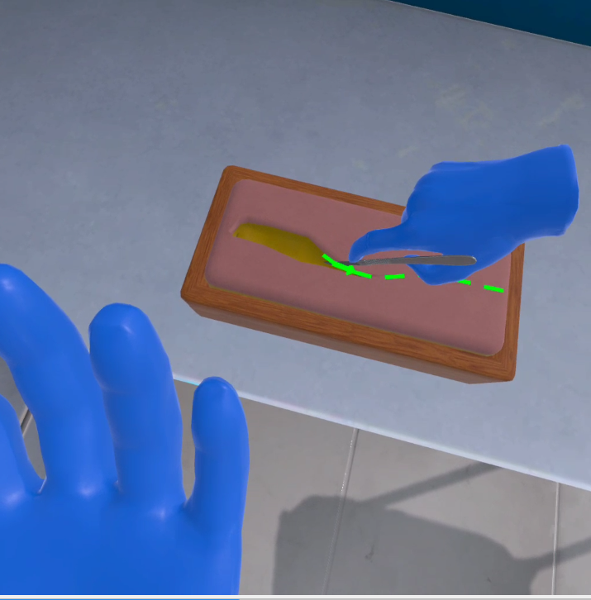
Performing Tasks
Fig.7 Performing cut

Slide 19
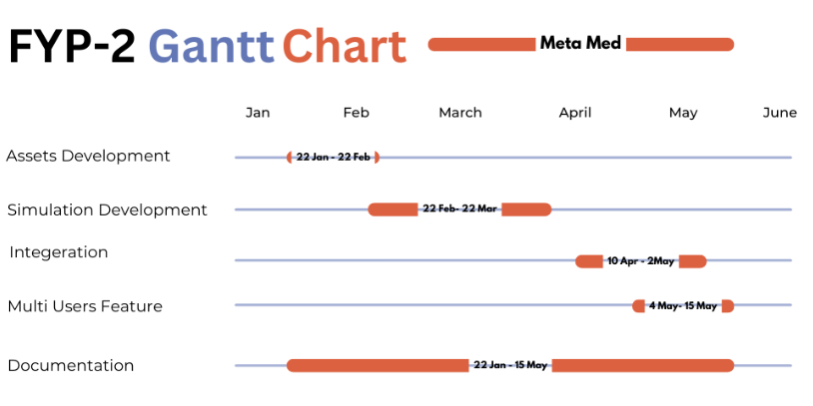

Slide 20
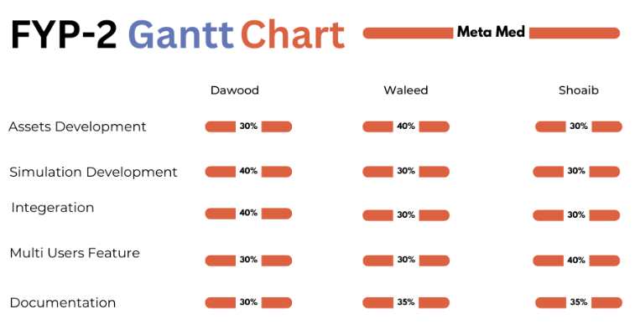

Slide 21
4. Demo

